Slide 1

Power point karaoké
Agicap unconf (June 20th, 2023) inspired by Hugo Fernandez

Slide 2
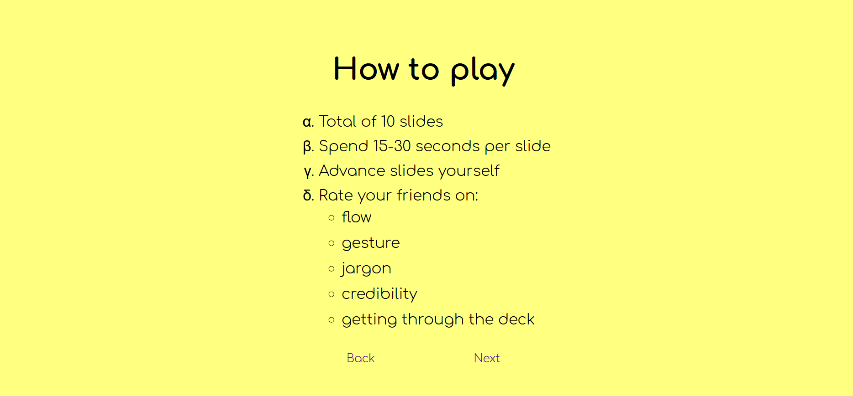
How to play
Spend 15-30 seconds per slide
Advance slides yourself
Rate your friends on:
Flow
Gesture
Jargon
Credibility
Getting through the deck

Slide 3
Healthy Habits

Slide 4

Healthy Habits
Slide 1 of 10

Slide 5
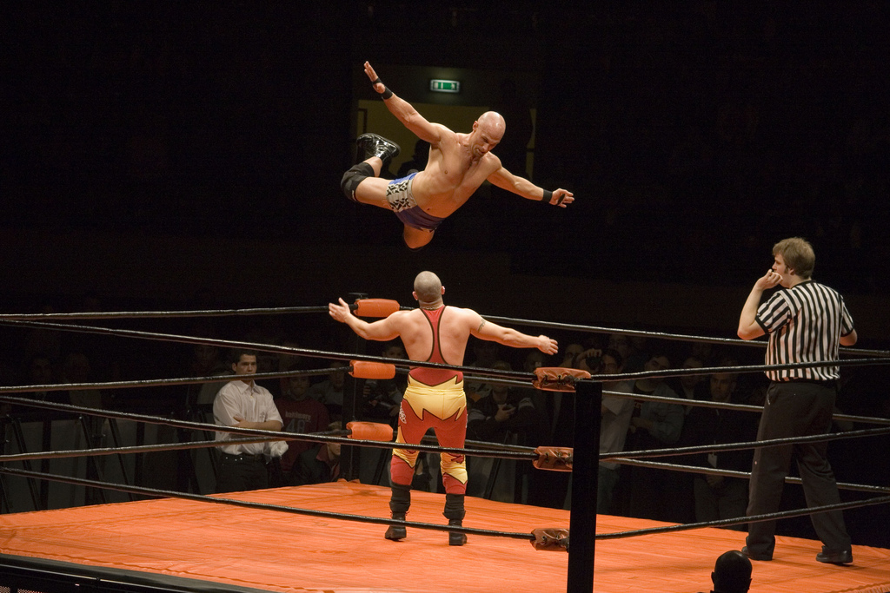
Source: Hugo Fernandez
Slide 2 of 10

Slide 6
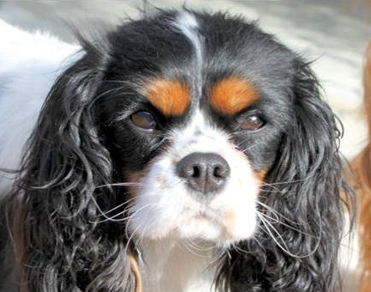
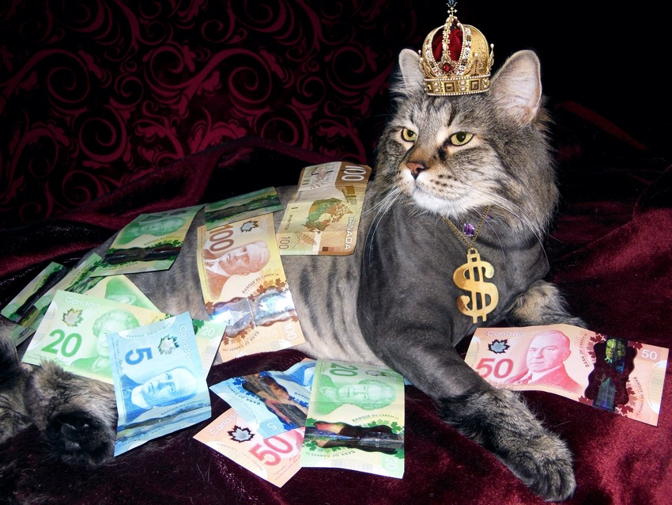
Slide 3 of 10

Slide 7
Slide 4 of 10

Slide 8



Slide 5 of 10

Slide 9
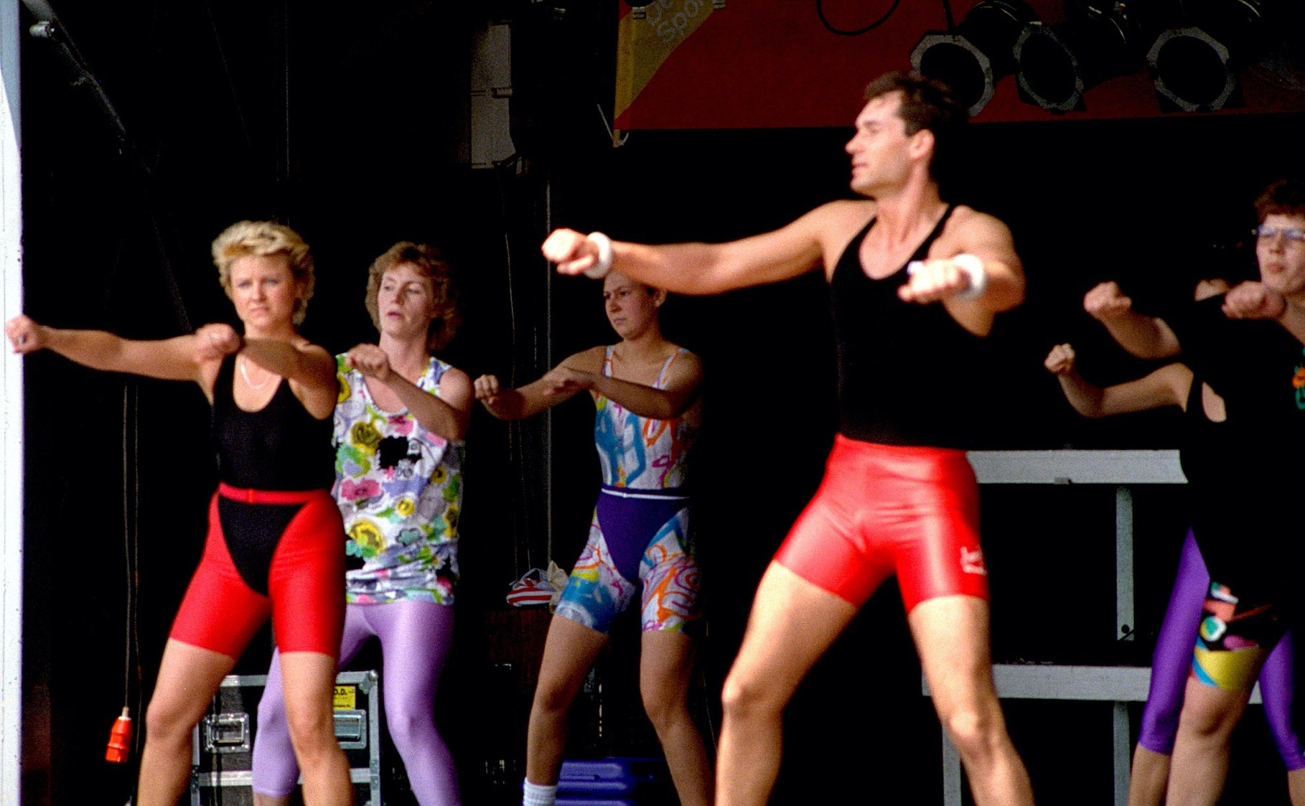
Slide 6 of 10

Slide 10
Slide 7 of 10

Slide 11
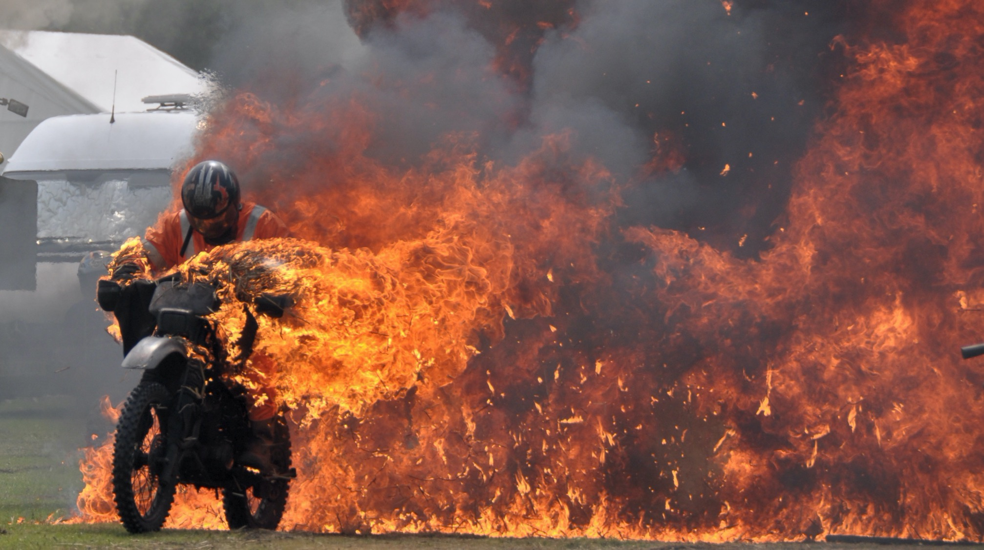
Slide 8 of 10
Source: Paul Stevenson

Slide 12

75%
Slide 9 of 10
Slide 5 of 10

Slide 13
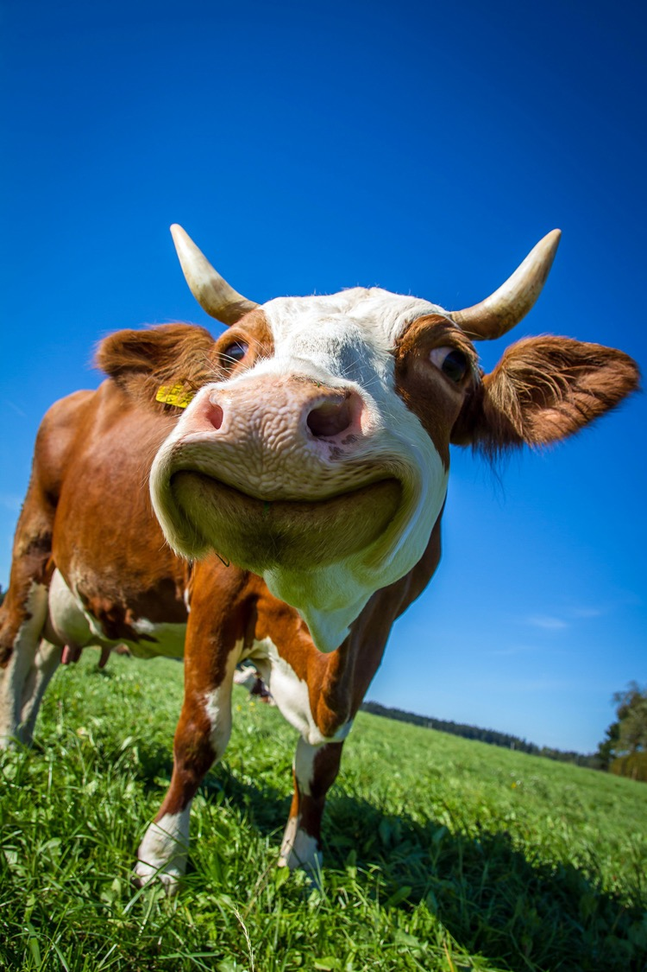
I’m not wearing pants
Slide 10 of 10

Slide 14
And you’re done!
Please give a round of applause

